Slide 1
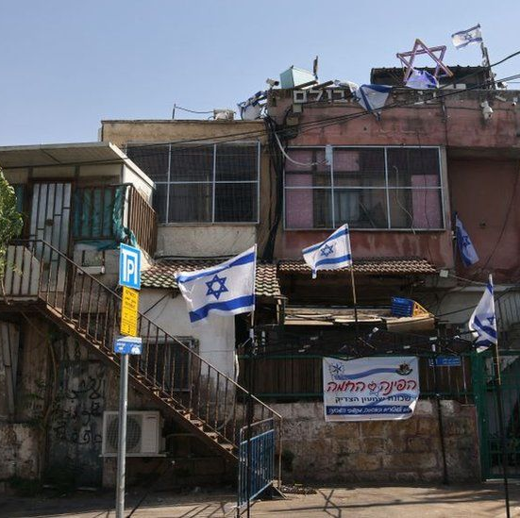
What are the consequences of Israel’s annexation of East Jerusalem for Palestinians?
Lesson 17

Slide 2
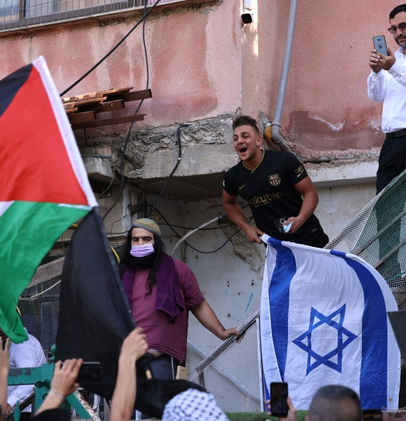
Learning objectives
By the end of this lesson, you should be able to:
Describe Israel’s annexation of East Jerusalem
Describe what the Separation Wall is
Explain the consequences of both of these for Palestinians

Slide 3
17a. Cut out and match the keywords with the definitions
a 6-8m high wall built by Israel that runs along the border between Israel and the occupied West Bank
Occupation
the forcible acquisition (taking control) of land
Annexation
when someone is forced to leave a house or piece of land
East Jerusalem
Eviction
invasion and temporary control over a territory
Separation Wall
the eastern half of Jerusalem

Slide 4
Stick the matching keywords and definitions into your glossary
invasion and temporary control over a territory
Occupation
the forcible acquisition (taking control) of land
Annexation
the eastern half of Jerusalem
East Jerusalem
when someone is forced to leave a house or piece of land
Eviction
a 6-8m high wall built by Israel that runs along the border between Israel and the occupied West Bank
Separation Wall

Slide 5
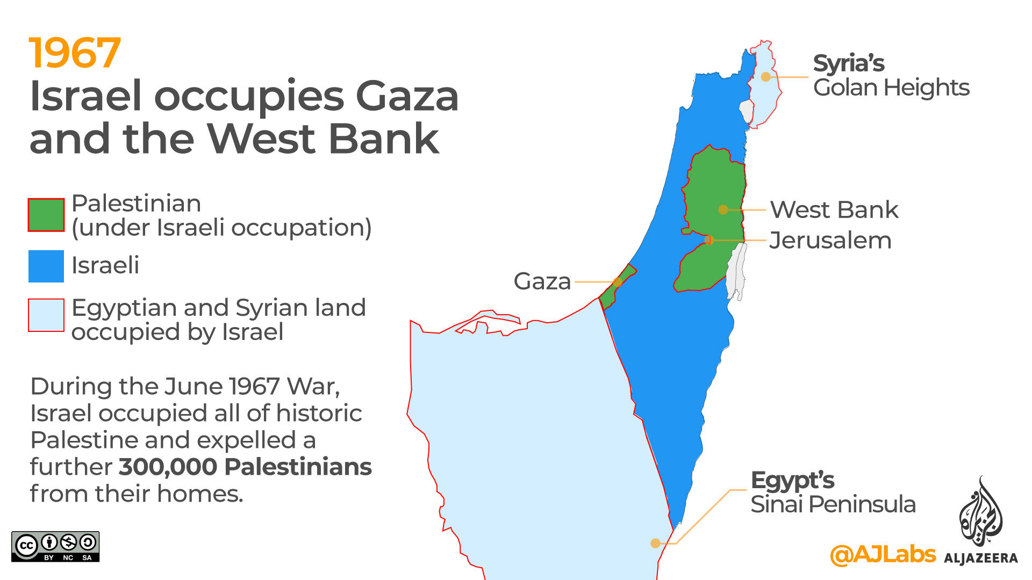
Israel’s annexation of East Jerusalem
After occupying East Jerusalem in 1967, Israel annexed East Jerusalem in 1980
What is annexation?
The forcible acquisition (taking control) of land
Why was this illegal under international law?
Because after 1967 East Jerusalem was occupied territory
Under international law, you cannot make occupied territory your own
Israel’s annexation of East Jerusalem was condemned by UN Security Council Resolution 478 in 1980
With a partner, answer these questions:
What had happened in 1967?
Was Israel’s annexation of East Jerusalem in 1980 legal? Why/why not?
Extension question: What is the difference between occupation and annexation?

Slide 6
In small groups:
What differences can you identify between East and West Jerusalem?
Write these down

Slide 7
Today’s key question: What are the consequences of Israel’s annexation of East Jerusalem for Palestinians?
Two main consequences:
Evictions and home demolitions
Restricted movement

Slide 8
Today’s key question: What are the consequences of Israel’s annexation of East Jerusalem for Palestinians?
Two main consequences:
Evictions and home demolitions
Restricted movement

Slide 9
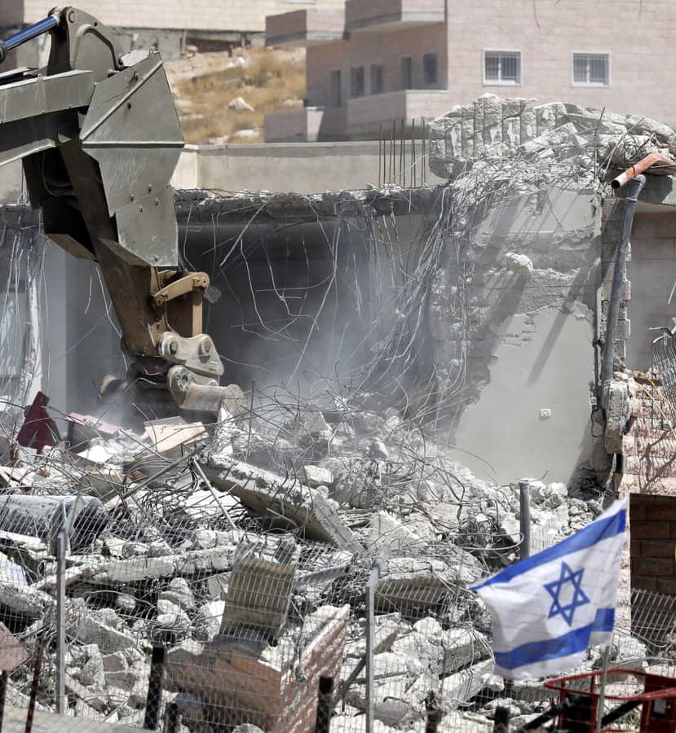
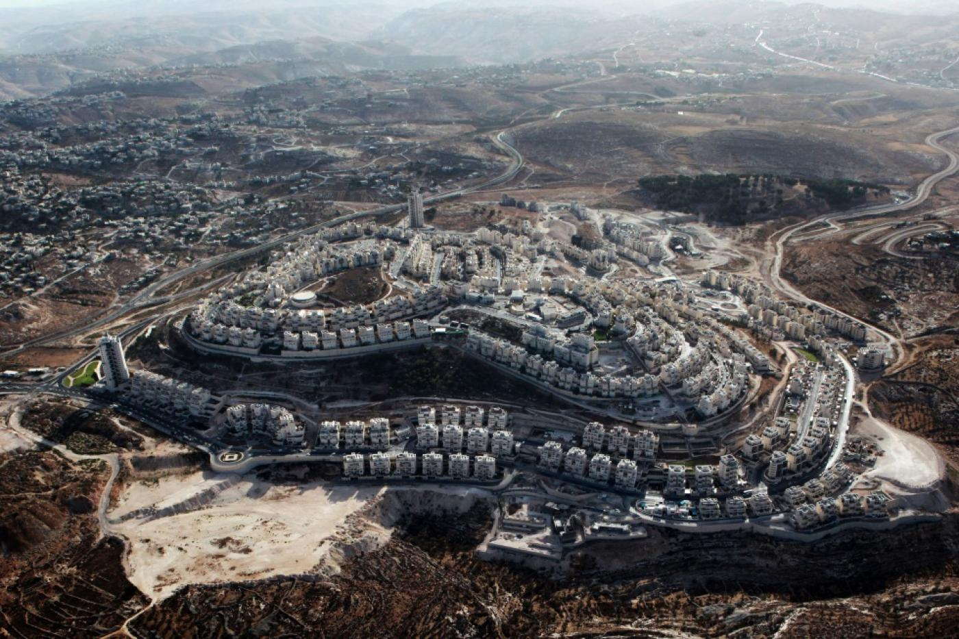
Evictions and home demolitions
What is eviction?
When someone is forced to leave a house or piece of land
What is home demolition?
The destruction of a home
In East Jerusalem, Palestinians face evictions & home demolitions to make way for illegal Israeli settlements
Since 1967, Israel has demolished 1000 Palestinian homes in East Jerusalem
Since 1948, Israel has demolished over 100,000+ Palestinian homes in total

Slide 10
#SaveSheikhJarrah
https://www.youtube.com/watch?v=vs0EQJ4bacE
Sheikh Jarrah is a neighbourhood in East Jerusalem
In May 2021, Palestinian families here faced evictions from their homes to make way for illegal Israeli settlers
#SaveSheikhJarrah started trending on social media. It soon made international headlines

Slide 11
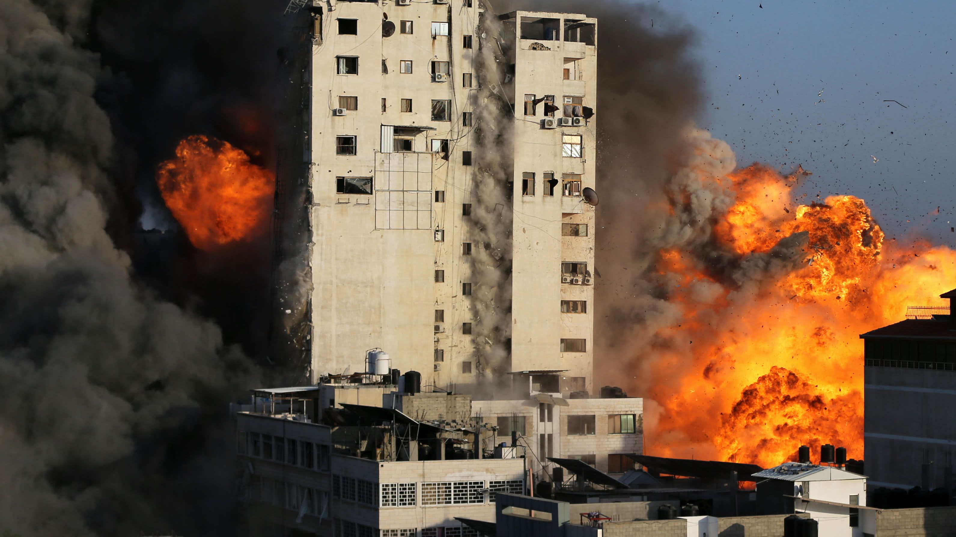
2021 Israel-Palestine Crisis
The events in Sheikh Jarrah in East Jerusalem triggered the “2021 Israel-Palestine Crisis”
6th-21st May 2021
Over 250 Palestinians were killed, half of them civilians
In Gaza, Israel bombed civilians and has been accused of war crimes for its actions
This shows that what happens in East Jerusalem is important. It impacts all of Palestine and Israel
#SaveSheikhJarrah

Slide 12
Israeli attacks on Gaza in May 2021
Watch the video
https://www.youtube.com/watch?v=5kJFIKER1k8

Slide 13
17b. Read the information and answer the questions below in groups:
A war crime is the breaking of one of the laws of war. The laws of war were introduced after the atrocities of World War Two (eg. the Holocaust).
War crimes include the deliberate and unprovoked destruction of communities, devastation beyond military necessity and the ill-treatment, torture or murder of civilians living under occupation.
War crimes are among the gravest crimes in international law. They are so serious that there is no time limit for when someone can be punished for committing them.
Why has Israel been accused of war crimes for its attacks on Gaza in May 2021?
2. Have you come across any other examples of war crimes in Palestine-Israel?

Slide 14
17c. Using this information, how would you feel if you were Palestinian and lived in East Jerusalem?
Extension question: what one word would you choose to sum up how you feel?

Slide 15
How would you feel if you were Palestinian and lived in East Jerusalem?

Slide 16
Mohammad, Abdullah, Adam and their grandfather describe what it was like when Israeli authorities demolished their family home in East Jerusalem with just ten minutes' notice
https://www.youtube.com/watch?v=z-8HHY_ge_g

Slide 17
Today’s key question: What are the consequences of Israel’s annexation of East Jerusalem for Palestinians?
Two main consequences:
Evictions and home demolitions
Restricted movement

Slide 18
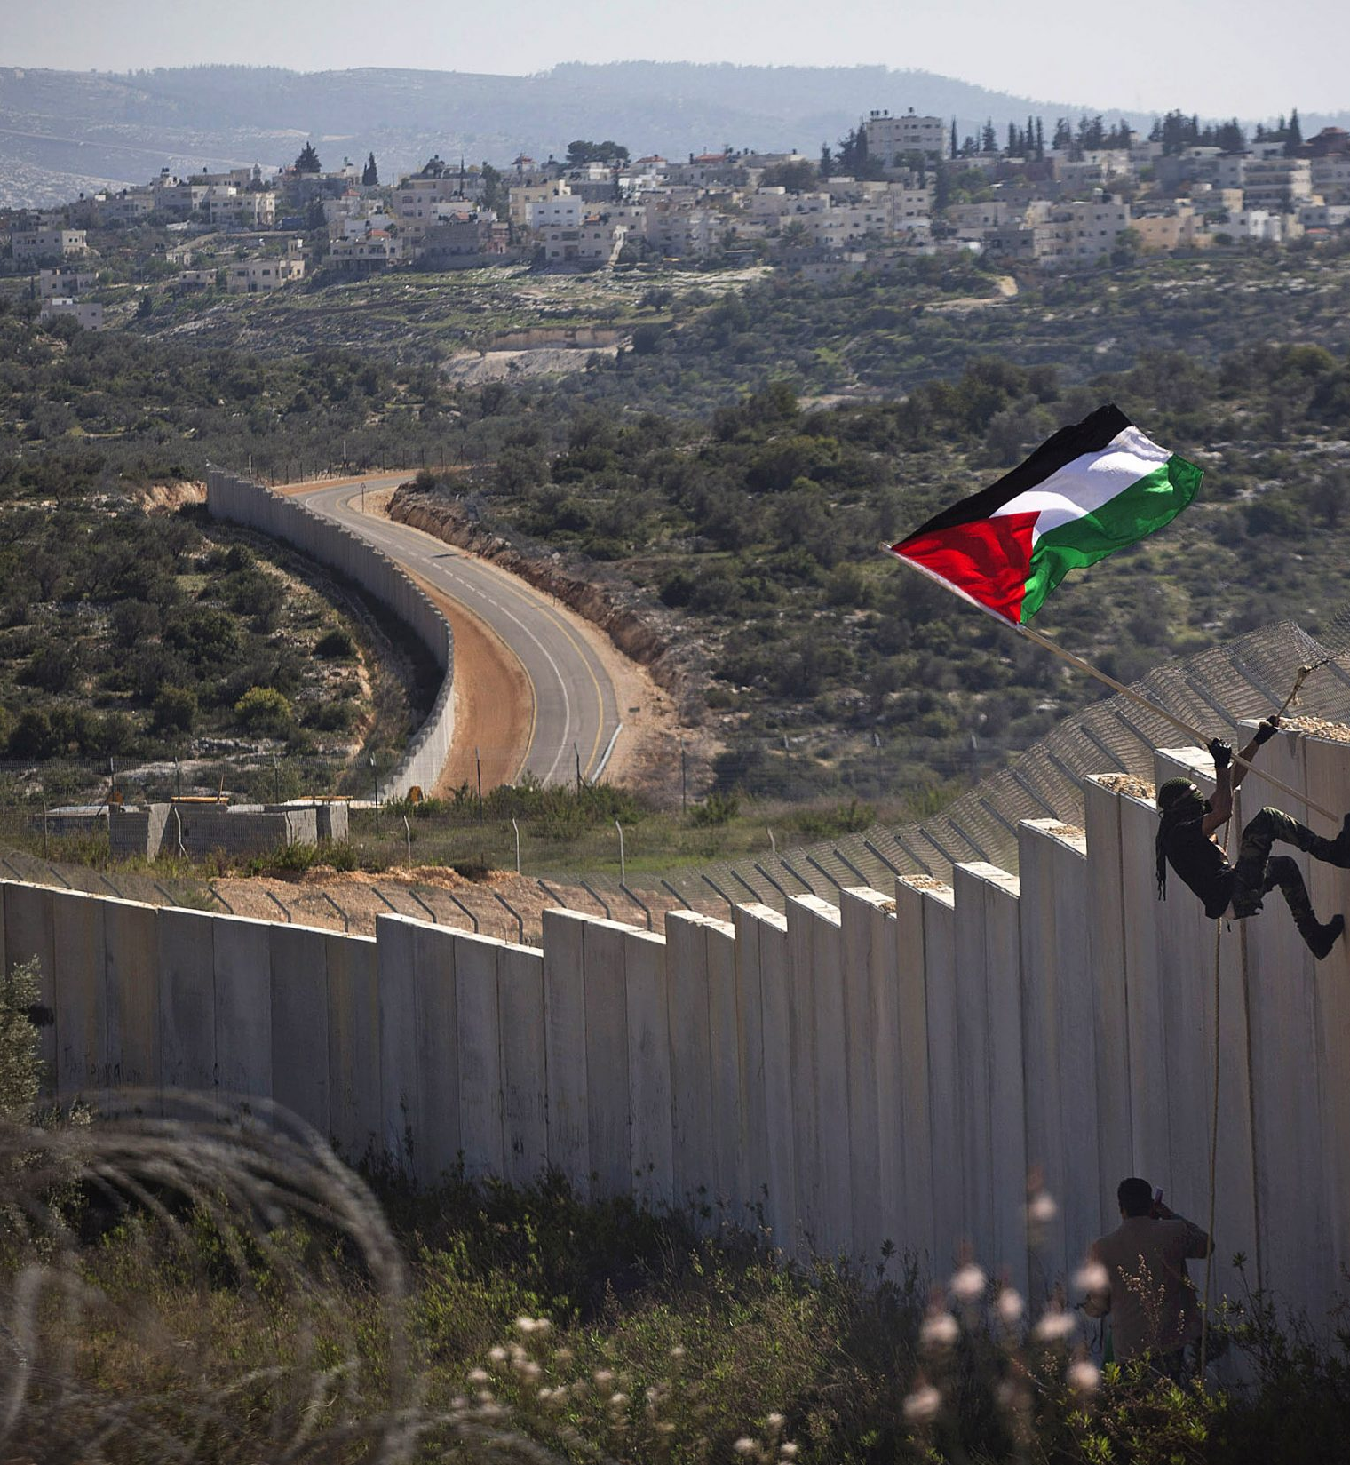
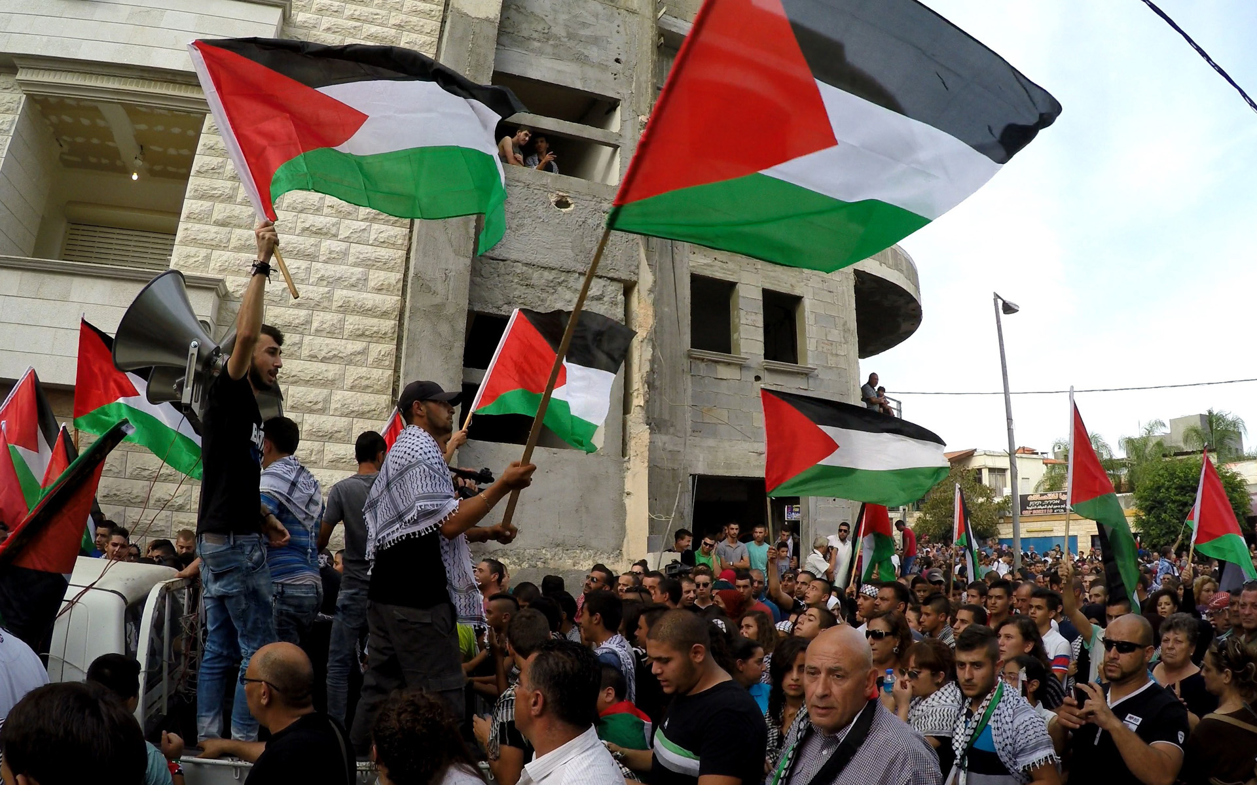
Restricted movement
What was the Second Intifada?
During the Second Intifada (2000-2005), Israel built a Separation Wall along its border with the occupied West Bank
Israel started building the wall for security reasons, but has since been criticised for using the wall to take more Palestinian land
The wall is 6-8 metres high and when finally completed it will be over 700km in length
The Wall severely impacts the freedom of movement of Palestinians

Slide 19
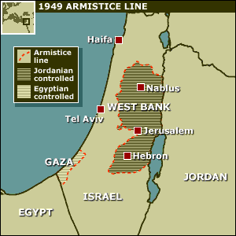
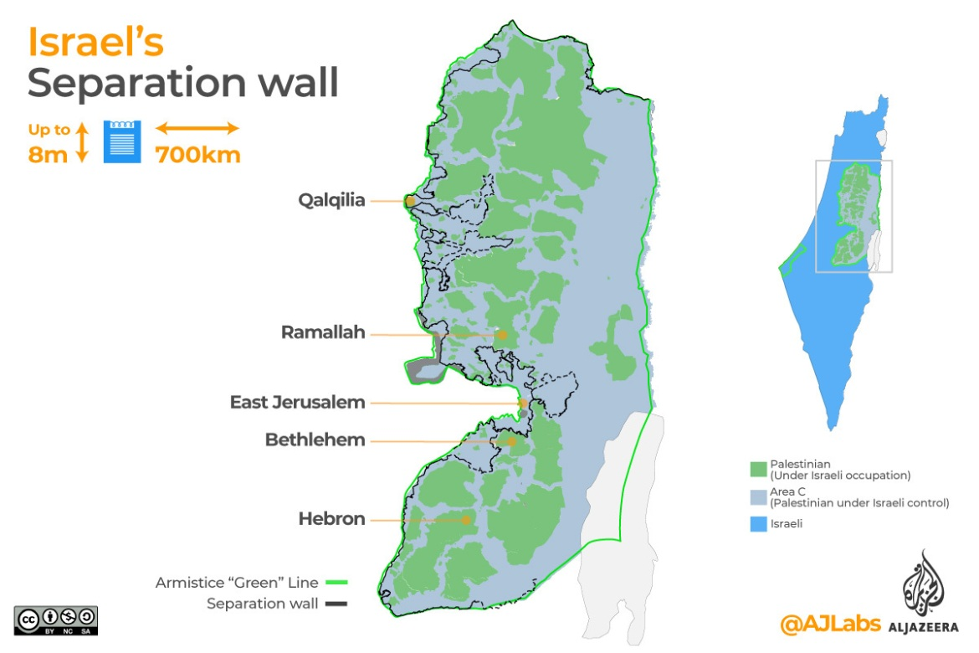
The consequences of the Wall for Palestinians
Can you remember why it was called the Green Line?
Because green was the colour of the ink that the line was drawn in on the maps
The Wall has severely damaged Palestinian agriculture, towns and villages
225 water sources have been taken from the Palestinians by the route of the Wall
The Wall is meant to run along the Green Line of 1949, but at times it penetrates up to 16km into Palestinian land
Around 300,000 Palestinians have been cut off from their communities by the Wall. They are trapped between the Wall and the Green Line

Slide 20
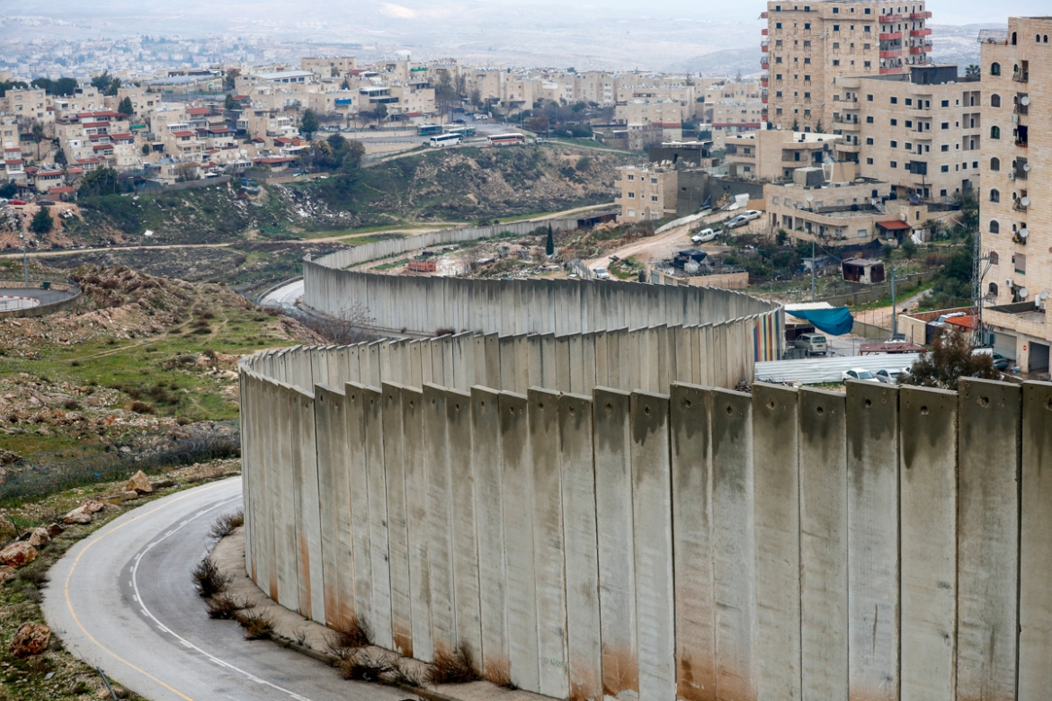
The Wall in East Jerusalem
The Wall runs around Israeli settlements and cuts East Jerusalem off from the rest of the occupied West Bank
This means it is almost impossible for Palestinians in East Jerusalem to travel to other parts of occupied Palestine to see family and friends
The Separation Wall has many different names:
Israelis call it the Security Wall
Palestinians call it the Separation Wall, Apartheid Wall or Racial Segregation Wall

Slide 21
The Wall & international law
In 2004, the International Court of Justice stated that the Separation Wall was
‘contrary to international law’
and called on Israel to
‘cease forthwith the works of construction of the Wall’ and ‘dismantle forthwith the structure therein situated’

Slide 22
17d. Restricted movement for Palestinians in East Jerusalem
1) What is the Separation Wall?
2) What impact does the Separation Wall have on the freedom of movement of Palestinians in East Jerusalem?

Slide 23
17e. You will now be assigned either Noa or Zeid.
Pair up with someone who has been assigned a different name to you.
Use the information on your sheets to help each other fill in the boxes.

Slide 24
How is life different for illegal Israeli settlers and Palestinians in East Jerusalem?
How does this make you feel?

Slide 25
Plenary
One thing you would like to know more about
Draw this pyramid in your book and write in:
Two things you enjoyed in today’s lesson
Three things you learnt today

Slide 26
One thing you would like to know more about
Homework:
Use the internet to find out two things about this. Write the information down in your book

